Slide 1



Basic Local Alignment Search Tool
Stephen F. Altschul, Warren Gish, Webb Miller
Eugene W. Myers and David J. Lipman
Notes:
1990

Slide 2
Challenge
Find regions of similarity between one sequence and other sequences.
Software tools for searching sequence use some measure of similarity.
  dynamic programming algorithm (scores to insertions, deletions and replacements)
The cost of this alignment is a measure of similarity.
Notes:
To grow in size they become increasingly useful in the analysis of newly sequenced genes and proteins .
The algorithm guarantees it is optimal, based on the given score
compute an alignment of two sequences that corresponds to the least costly set of such mutations.
Because of their computational requirements, dynamic programming algorithms are impractical for searching large databases.
FASTP first finds locally similar regions between two sequences based on identities but not gaps, and then re scores these regions using a measure of similarity between residues, such as a PAM matrix

Slide 3
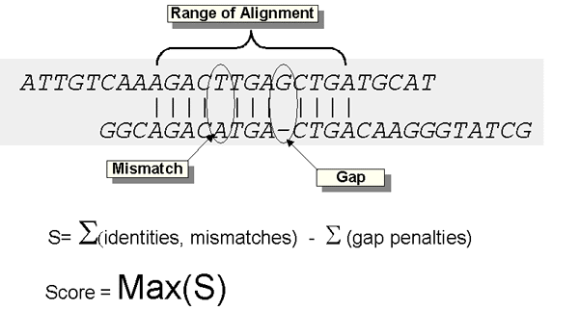
Score Calculation

Slide 4
BLAST
Employs a measure based on well -defined mutation scores.
The maximal segment pair measure (MSP).
Local X Global
Notes:
It d i r e c t l y a p p r o x i m a t e s the results that would be o b t a i n e d by a d y n a m i c p r o g r a m m i n g a l g or i t h m f o r optimizing the measure.
Is m o r e than an order of m a g n i t u d e f a s t e r t h a n e x i s t i n g h e u r i s t i c a l g o r i t h m s .
Global alignment may include large stretches of low similarity
Local similarity algorithms seek only relatively conserved subsequences, a n d a single comparison may yield several distinct subsequence alignments;
unconserved regions do not contribute to the measure of similarity
Begin with a matrix of similarity scores
MSP is the highest scoring pair of identical length segments chosen from 2 sequences.
B L A S T can seek all locally maximal , v e n t pairs with scores above some cutoff
Mathematical results allow the statistical significance of MSP scores to be estimated under an appropriate random sequence model.
Furthermore, for any particular scoring matrix (e.g. PAM-1-20) one can estimate the frequencies of paired residues in maximal segments.

Slide 5
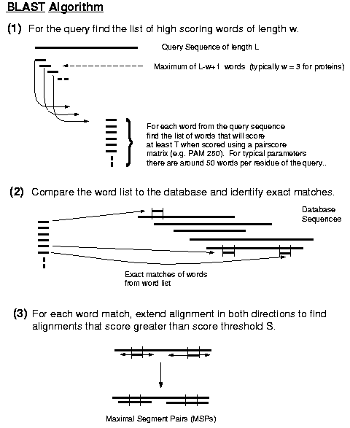
Notes:
Minimizes the time spent on sequence regions whose similarity with the query has little chance of exceeding this score
A low value for T reduces the possibility of missing MSPs with the required S score, however lower T values also increase the size of the hit list generated in step 2 and hence the execution time and memory required. In practice, the BLASTP program used for protein searches sets compromise values of T and X to balance the processor requirements and sensitivity.

Slide 6
Optimization
Minimizes the time spent on sequence regions whose similarity with the query has little chance of exceeding this score

Slide 7
BLAST Family
blastp - compares an amino acid query sequence against a protein sequence database
blastn - compares a nucleotide query sequence against a nucleotide sequence database
blastx - compares the six-frame conceptual translation products of a nucleotide query sequence (both strands) against a protein sequence database
tblastn - compares a protein query sequence against a nucleotide sequence database dynamically translated in all six reading frames (both strands)
tblastx - compares the six-frame translations of a nucleo- tide query sequence against the six-frame transla- tions of a nucleotide sequence database
PSI-BLAST - Position-Specific Iterated BLAST. This is a potentially very sensitive method to pull out significant hits in a protein-protein database search. This first performs a gapped BLAST database search. The PSI-BLAST program uses the information from any significant alignments returned to construct a position-specific score matrix, which replaces the query sequence for the next round of database searching. PSI-BLAST may be iterated until no new significant alignments are found.
The default matrix for all protein-protein comparisons is BLOSUM62.

Slide 8
Applications
Straightforward DNA and protein sequence database searches,
Motif searches,
Gene identification searches,
In the analysis of multiple regions of similarity in long DNA sequences

Slide 9
Examples
http://www.youtube.com/watch?v=agv-sbE06cc
www.ncbi.nlm.nih.gov

Slide 10
Referências
http://www.cbi.pku.edu.cn/docs/faq/BlastSpecifics.html
http://csb.stanford.edu/class/public/readings/Bioinformatics_I_Lecture6/Altschul_JMB_90_BLAST_Sequence_alignment.pdf
http://blast.ncbi.nlm.nih.gov/Blast.cgi

